Slide 1
Group 4 Good Eats

Slide 2
Will our Restaurant be successful in San Francisco?
Questions to answer?
Cuisine?
Neighborhood
Price point?
Comp restaurant to Close Neighborhood?

Slide 3
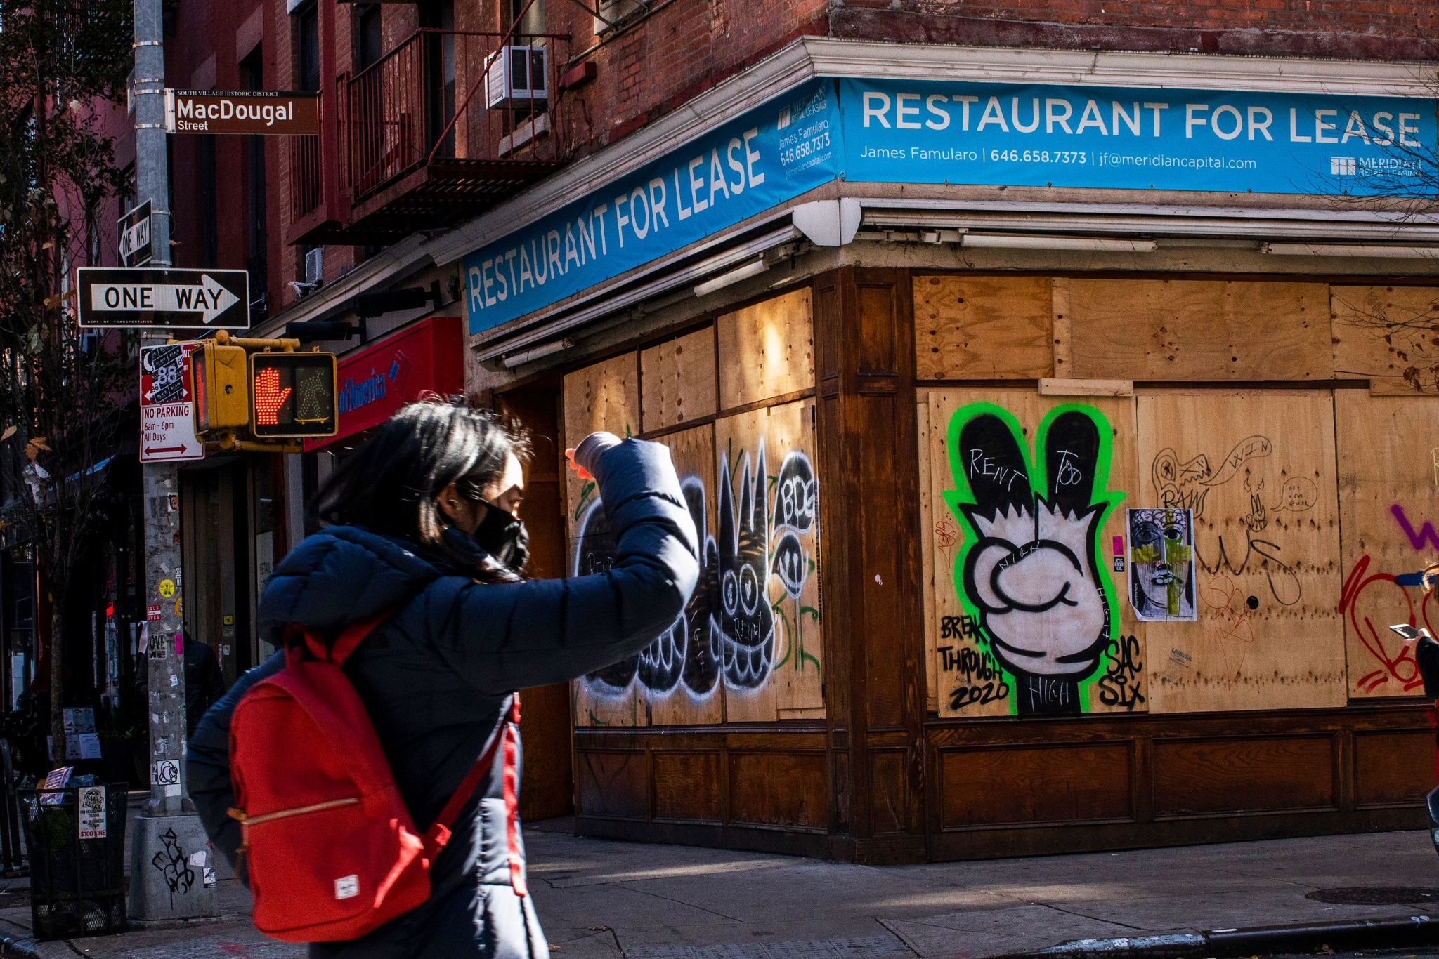

Why this topic?
Restaurant business is difficult industry
This Machine Learning Model can serve as a prototype to sell in different markets to evaluate competition
This analysis looks at several variables
Price Point
# of Reviews
Comparable restaurants to measure a gap to be filled?
Neighborhoods

Slide 4
Data Exploration
What factors play a role in a successful restaurant?
Is there a relationship between number of cuisines, number of competitors, price that make a restaurant successful?
Does the number of reviews for a restaurant dictate success or failure?

Slide 5

Data Analysis

Slide 6
Data Source
Restaurant data set is from API call from Yelp (Link?)
Neighborhood data- GEOJSON file from the city of San Francisco's government data website- Link?

Slide 7
Technologies
Data cleaning
Google Colab
Jupyter Notebook
VS Code
Machine Learning
Jupyter Notebook- Logistic Regression Model
Database
Microsoft Azure
Data Scaping
Kaggle
Zomato
Yelp
Dashboards
HTML
Tableau

Slide 8

Future Analysis
Explore different markets to help predict successful restaurant launches
Aid Restaurateur investors decision making for high level market analysis
Assist in other service industries that rely on Google, Yelp, BBB reviews

